Slide 1
Smart Autonomous DL-Based Tomato Harvesting Robot
PIP2001 Capstone Project
Review-1
Under the Supervision of,
Associate Professor : PING LANG-YEN
DEPARTMENT OF BIOMECHATRONICS AND AGRICULTURAL ENGINEERING.
Roll Number | Student Name
20211CIT0143 | ARYAN RAJESH
Name of the Program: B-TECH CSE-IOT
Name of the HoD: DR. ANANDARAJ S.P.
Name of the Program Project Coordinator: Dr. R. Ruhin Kouser
Name of the School Project Coordinators: Dr. Sampath A K / Dr. Abdul Khadar A / Mr. Md Ziaur Rahman

Slide 2
Introduction
The Title of my Project is "Smart Autonomous DL-Based Tomato Harvesting Robot". This is a very Large-scale project with a Long Way to go(Approximately 5 ~ Years), jointly being Developed by NTU RMML Lab and The Ministry of Agriculture and Industrial Development of Taiwan.
A brief description of my work is given below.
I was a research Intern at the RMML Lab under the Tomato Harvesting Project (Computer Vision) in the Bio-Mechatronics and Agricultural Department. I was selected for this program by Prof. Ping Lang-yen through the TEEP Program. My Goal was to Generate the point Cloud of the whole Tomato Cluster, Process it and Perform Gaussian Splatting and 3d Reconstruction of the Artificial Tomato Cluster to increase the accuracy of the tomato detection(3D vs 2D) and perform Orientation Determination of the robotic arm w.r.t. to the Cherry Tomato. I also conducted the V-Slam and captured the Point Cloud of the Phantom tomato.

Slide 3
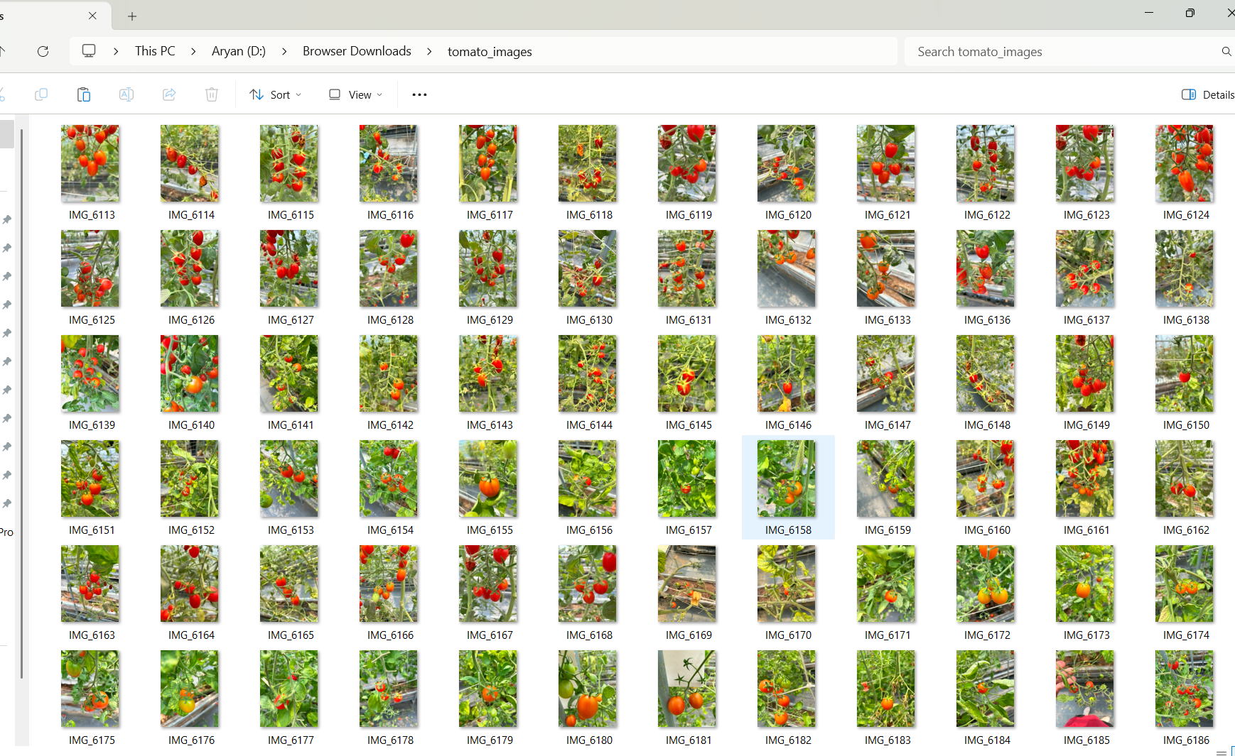
Dataset Collection

Slide 4
Introduction
Purpose of this Project?
Shortage of Labor and its High Costs: Mechanization of harvesting has solved the problem of labor shortage and avoided high costs related to manual work in Taiwan.
Improved Efficiency: Machines could harvest continuously and rapidly whereby larger areas could be covered with far less labor than in the case of manual working.
Reducing Post-Harvest Losses: Automated tomatoes handling machines do not damage tomatoes; thus the losses are reduced.
Data-Driven Precision Agriculture: Equipped with sensors and artificial intelligence, the machine supports data-driven crop management and the optimal practices of farming.

Slide 5
Literature Review
Computer Vision in Agriculture Review: 2D vs. 3D vision for crop monitoring based on the advantages of 3D reconstruction and point cloud processing in accurate fruit detection.
Deep Learning Techniques for Fruit Detection : A review of deep learning approaches such as Convolutional Neural Networks for fruit recognition in overcoming challenges such as occlusion, lighting, and varying ripeness of fruits.
3D Point Cloud Processing and Gaussian Splatting: Explain the techniques of 3D point cloud and how Gaussian Splatting can improve accuracies for reconstruction of fruit clusters and to use it as an aid for robots.
SLAM for Agricultural Robotics: Explain the SLAM principles applied to V-SLAM operating in scenarios like autonomous navigation and crop mapping.

Slide 6
Existing method Drawback
No 3D Gaussian Splat Model of the Cherry Tomato on the Web4
Till date no V-Slam is conducted on the Cherry Tomato
Only 2D detection is available (*yolo)
3d Detection is more accurate but was never implemented previously in any of the Commercial Project.
Accuracy of the Robot arm is very low to accurately detect the small Cherry tomato for the hook to grab the Cherry Tomato

Slide 7
Proposed Method
Conduct V-SLAM (Visual Simultaneous Localization and Mapping):
Utilizes visual information to track camera motion and map the environment in real time.
Provides spatial structure and information of orientation of the camera for the reconstruction of 3D space.
3D Point Cloud Generation, Pre-processing, and Alignment:
Captures spatial data describing the geometry of objects which gets filtered and smoothed to remove noise.
Align multiple point clouds by using registration techniques to create a richer 3D model.
Implement 3D Gaussian Splatting (3DGS).
Recursive Rendering of 3D Scenes using Gaussian Splats for Smooth and High-Resolution Surface Approximations by Object Reconstructions
Efficient and High-Resolution Reconstruction by Traditional Methods Fail
Create a Scanning and Reconstruction Algorithm:
Capture multiple views for complete surface coverage of the target object
Complete 3D modeling with techniques which merge and refine the scanned data.

Slide 8
Loftr Analysis
LoFTR is an attention-based DL Learning method designed to match points in two images across large viewpoint differences which can be used for Pose Estimation and 3D Reconstruction from 2D images.
The Reasons of Conducting Loftr Analysis are Listed Below:
Detector-Free Matching: This Feature Based Matching eliminates the need for Separate KeyPoint Detection and Algorithm
Improved Tracking Robustness: LoFTR's dense matching reduces tracking failures in VO pipelines.
Enhanced Pose Accuracy and Estimation: It Provides more precise feature correspondences leading to better pose estimation and Object Poses.
Real-Time Performance: Optimizes LoFTR's implementation to achieve low-latency processing suitable for real-time applications.

Slide 9
Objectives
Conduct V-SLAM (Visual Simultaneous Localization and Mapping):
Utilizes visual information to track camera motion and map the environment in real time.
Provides spatial structure and information of orientation of the camera for the reconstruction of 3D space.
3D Point Cloud Generation, Pre-processing, and Alignment:
Captures spatial data describing the geometry of objects which gets filtered and smoothed to remove noise.
Align multiple point clouds by using registration techniques to create a richer 3D model.
Implement 3D Gaussian Splatting (3DGS).
Recursive Rendering of 3D Scenes using Gaussian Splats for Smooth and High-Resolution Surface Approximations by Object Reconstructions
Efficient and High-Resolution Reconstruction by Traditional Methods Fail
Create a Scanning and Reconstruction Algorithm:
Capture multiple views for complete surface coverage of the target object
Complete 3D modeling with techniques which merge and refine the scanned data.

Slide 10
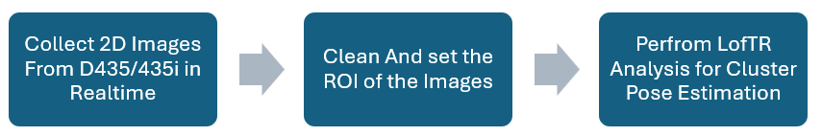
Methodology/Modules
Point Cloud (Depth Camera)
Point Cloud Extraction
V-Slam
220 Degree Reconstruction
3D Tomato Reconstruction
First was Gaussian Splatting Reconstruction.
Multiple Camera Poses (JSON)
Multiple Camera Transformation Matrix
Pre-Processing
Trash Point Cleaning
Alignment
Second is Taichi 3d Splatting Reconstruction @ 60.00 FPS

Slide 11
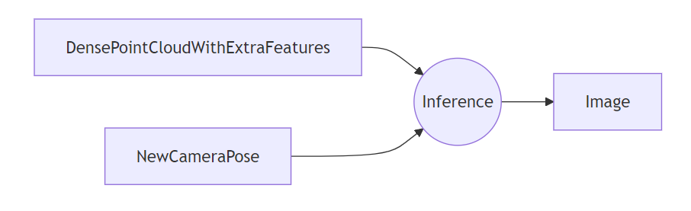
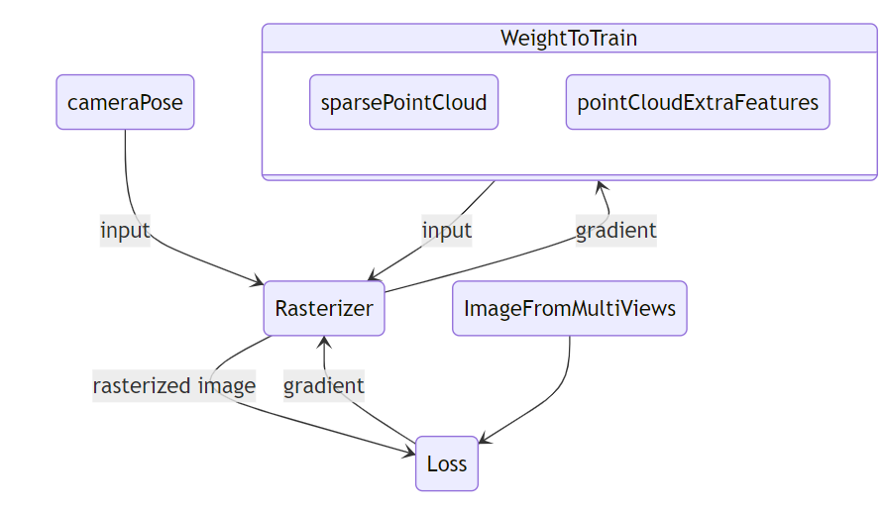
Methodology/Modules

Slide 12
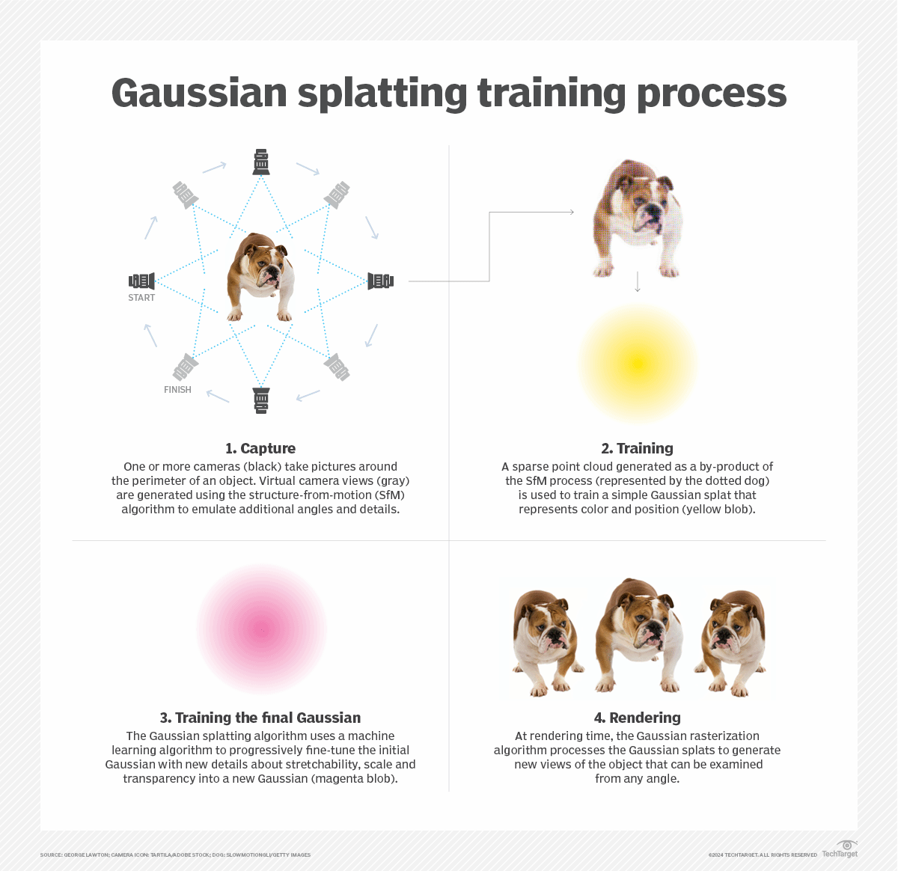

Slide 13
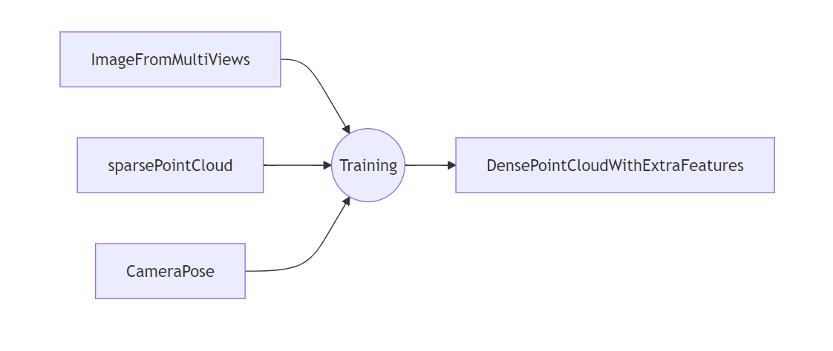
Architecture

Slide 14
Hardware/software components
Hardware
Intel Realsense Depth Camera D435i and D435
Nvidia Jetson Orin
Camera Tripod
Phantom tomato
Robotic Arm (ABB)
Miscellanous Tools
Software
Specatular Ai
Ubuntu 22.04
ROS 2 Humble /Rviz/Rtmap/Noetic
Cloud Compare
Intel Real-Sense Viewer/Depth Quality Viewer
Spectacular AI
Cuda ToolKit 11.7/11.8
Nerfstudio (NS-Train)
Open Ai – Point-E
Intel Midas Model
Foundation 6D Pose Nvidia CVPR 2024

Slide 15
Timeline of Project
July- Point Cloud Reconstruction and Pre-Processing
August - LofTR Analysis and V-slam
September - 3D Gaussian Splatting ,Taichi Splatting , Scanning Algorithm.

Slide 16
Expected Outcomes
High-Quality Reconstruction:
Smooth and dense 3D models enhance the robot's ability to identify individual tomatoes.
Noise reduction for high-quality reconstructions of the point cloud data.
Real-Time Visualization:
It provides fast rendering of 3D scenes at high frame rates, which is very important for real-time computation.
Rapid visualization of the scene helps tomato identification and harvesting.
Noise in Sensor Data:
Noise caused by depth cameras is reduced for higher reliability of the data.
Point clouds become smooth to remove inconsistencies and errors while finding the tomatoes.
Optimize Robot Arm Movements for Tomato-Gathering Operations:
Provides high-resolution 3D mapping for high-precision motion control based on the shapes of tomatoes
Focuses in regions of densest occurrences for efficient harvesting.

Slide 17
Expected Outcomes
Precise and accurate 3D reconstructions of the clusters of tomatoes in detail through Gaussian splatting. This enables a robot to be able to distinguish between individual tomatoes based on their shapes.
Introduce real-time 3D visualization and analysis at higher frame rates such as 60 FPS so that the robot makes decisions, perhaps related to detecting and harvesting tomatoes, faster.
Gaussian splatting noise filtering for depth cameras, in outdoor environments, to ensure the data about tomato detection is accurate and no false detections.
Effective Robotic Arm Motion Planning
It produces accurate 3D workplace maps, which enable planning of exact movements by the robotic arm based on the shape and orientation of the tomatoes.
Utilize V-SLAM to capture multiple camera poses and transformation matrices, hence leading to a reconstruction environment that covers 220 degrees.
Develop point cloud alignment and preprocessing algorithms to clear trash points as much as possible and lead to a smooth reconstruction
Implement Gaussian and Taichi 3D splatting techniques to explore different reconstruction approaches.

Slide 18
Conclusion
Autonomous tomato harvesting robot development refers to combining state-of-the-art computer vision and 3D reconstruction techniques with robotic motion planning techniques to address problems in precision agriculture. All applied methods here, including V-SLAM, Gaussian splatting, and point cloud processing, will be used to gain appropriate and high-quality 3D reconstructions of tomato clusters. Real-time identification and harvesting of individual tomatoes by the robot will be possible in the most noisy outdoor environments. The project further focuses on the optimization of a robot's motion planning through reliable 3D maps to make point-to-point movements of the arm precise and economical. Robust scanning and reconstruction algorithms shall ensure seamless robot operation without interference from noise and other irrelevant data. Expected results will demonstrate the potentiality of developing a functional and efficient autonomous harvesting system that will significantly enhance agricultural productivity, in part minimizing labor input. The overall progress of real-time processing, noise management, and accuracy in the robot during this project will introduce more sustainable agriculture using a technology-based approach.

Slide 19
Github Link
No Permission given Due to Commercial Project Development.
All Project Data and codes are Uploaded to the NTU-RMML Server
http://140.112.94.139:5000/
Github Link

Slide 20
References
[1] Nichol, A., & Dhariwal, P. (2022). Point-E: A System for Generating 3D Point Clouds from Complex Prompts.
[2] Ranftl, R., Lasinger, K., Hafner, D., Schindler, K., & Koltun, V. (2022). Towards robust monocular depth estimation: Mixing datasets for zero-shot cross-dataset transfer. IEEE Transactions on Pattern Analysis and Machine Intelligence, 44(3), 1623-1637.
[3] CloudCompare (Version 2.x) [Computer software].
[4] Ding, C., Dai, Y., Feng, X., Zhou, Y., & Li, Q. (2023). Stereo vision SLAM-based 3D reconstruction on UAV development platforms. Journal of Electronic Imaging, 32(01). https://doi.org/10.1117/1.jei.32.1.013041.
[5] PViT-6D: Overclocking Vision Transformers for 6D Pose Estimation with Confidence-Level Prediction and Pose Tokens. (n.d.). https://arxiv.org/html/2311.17504
[6] Adityamwagh. (n.d.). GitHub - adityamwagh/3d-reconstruction-loftr: Pose estimation pipeline for 3D Reconstruction using LoFTR (Local Feature Transformer) detector free feature matcher. GitHub. https://github.com/adityamwagh/3d-reconstruction-loftr
[7] RecFusion - 3d Reconstruction Software. (2023, January 16). Download RecFusion | RecFusion - 3d Reconstruction Software. https://www.recfusion.net/download-recfusion/
[8] Gaussian Splatting & NeRFs — spectacularAI documentation. (n.d.). https://spectacularai.github.io/docs/sdk/tools/nerf.html
[9] Graphdeco-Inria. (n.d.). GitHub - graphdeco-inria/gaussian-splatting: Original reference implementation of “3D Gaussian Splatting for Real-Time Radiance Field Rendering.” GitHub. https://github.com/graphdeco-inria/gaussian-splatting
[10] Tancik, M., Weber, E., Ng, E., Li, R., Yi, B., Kerr, J., Wang, T., Kristoffersen, A., Austin, J., Salahi, K., Ahuja, A., McAllister, D., & Kanazawa, A. (2023). Nerfstudio: A Modular Framework for Neural Radiance Field Development. arXiv (Cornell University). https://doi.org/10.48550/arxiv.2302.04264
[11] Mildenhall, B., Srinivasan, P. P., Tancik, M., Barron, J. T., Ramamoorthi, R., & Ng, R. (2020). NeRF: Representing Scenes as Neural Radiance Fields for View Synthesis. arXiv (Cornell University). https://doi.org/10.48550/arxiv.2003.08934
[12] Wanmeihuali. (n.d.). GitHub - wanmeihuali/taichi_3d_gaussian_splatting: An unofficial implementation of paper 3D Gaussian Splatting for Real-Time Radiance Field Rendering by taichi lang. GitHub. https://github.com/wanmeihuali/taichi_3d_gaussian_splatting
[13] Wen, B., Yang, W., Kautz, J., & Birchfield, S. (2023). FoundationPose: Unified 6D Pose Estimation and Tracking of Novel Objects. arXiv (Cornell University). https://doi.org/10.48550/arxiv.2312.08344

Slide 21

Project work mapping with SDG

Slide 22
Thank You

